Slide 1
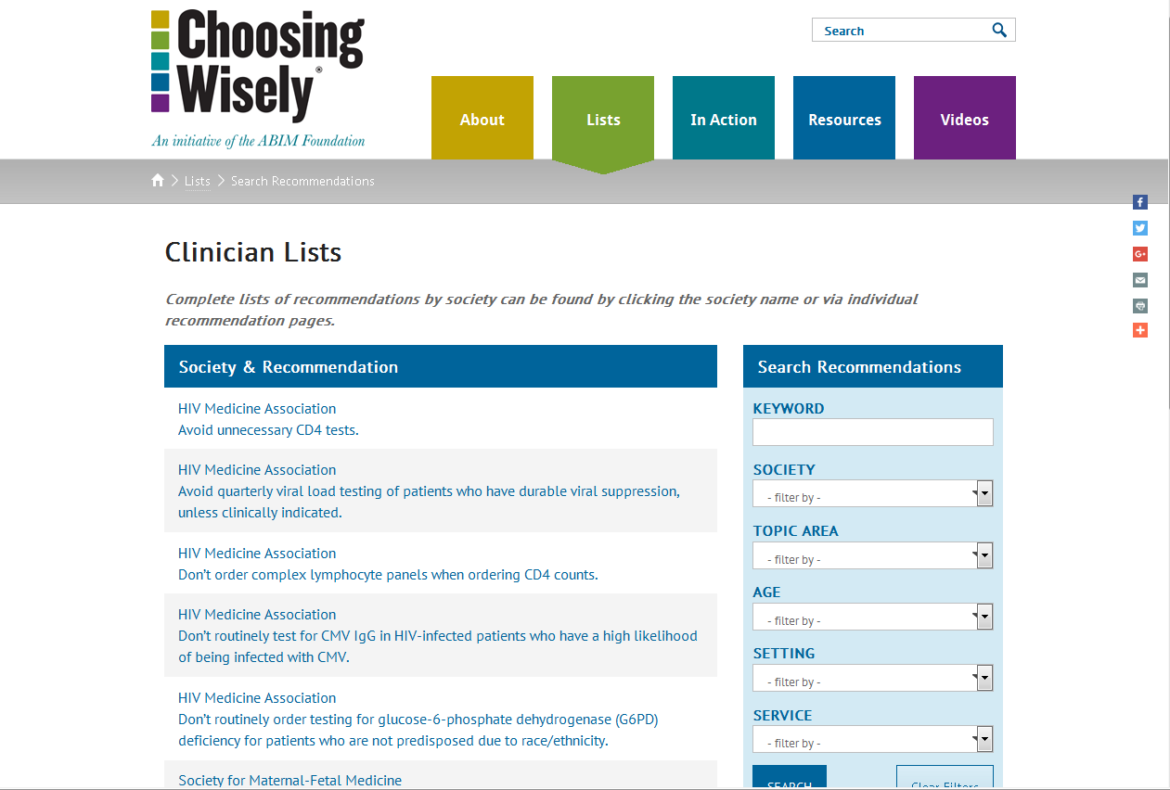

Slide 2
ACEP
American College of Emergency Physicians

Slide 3
1
Avoid computed tomography (CT) scans of the head in emergency department patients with minor head injury who are at low risk based on validated decision rules.

Slide 4
1
Minor head injury is a common reason for visiting an emergency department. The majority of minor head injuries do not lead to injuries such as skull fractures or bleeding in the brain that need to be diagnosed by a CT scan. As CT scans expose patients to ionizing radiation, increasing patients’ lifetime risk of cancer, they should only be performed on patients at risk for significant injuries. Physicians can safely identify patients with minor head injury in whom it is safe to not perform an immediate head CT by performing a thorough history and physical examination following evidence-based guidelines. This approach has been proven safe and effective at reducing the use of CT scans in large clinical trials. In children, clinical observation in the emergency department is recommended for some patients with minor head injury prior to deciding whether to perform a CT scan.

Slide 5
2
Avoid placing indwelling urinary catheters in the emergency department for either urine output monitoring in stable patients who can void, or for patient or staff convenience.

Slide 6
2
Indwelling urinary catheters are placed in patients in the emergency department to assist when patients cannot urinate, to monitor urine output or for patient comfort. Catheter-associated urinary tract infection (CAUTI) is the most common hospital-acquired infection in the U.S., and can be prevented by reducing the use of indwelling urinary catheters. Emergency physicians and nurses should discuss the need for a urinary catheter with a patient and/or their caregivers, as sometimes such catheters can be avoided. Emergency physicians can reduce the use of indwelling urinary catheters by following the Centers for Disease Control and Prevention’s evidence-based guidelines for the use of urinary catheters. Indications for a catheter may include: output monitoring for critically ill patients, relief of urinary obstruction, at the time of surgery and end-of-life care. When possible, alternatives to indwelling urinary catheters should be used.

Slide 7
3
Don’t delay engaging available palliative and hospice care services in the emergency department for patients likely to benefit.

Slide 8
3
Palliative care is medical care that provides comfort and relief of symptoms for patients who have chronic and/or incurable diseases. Hospice care is palliative care for those patients in the final few months of life. Emergency physicians should engage patients who present to the emergency department with chronic or terminal illnesses, and their families, in conversations about palliative care and hospice services. Early referral from the emergency department to hospice and palliative care services can benefit select patients resulting in both improved quality and quantity of life.

Slide 9
4
Avoid antibiotics and wound cultures in emergency department patients with uncomplicated skin and soft tissue abscesses after successful incision and drainage and with adequate medical follow-up.

Slide 10
4
Skin and soft tissue infections are a frequent reason for visiting an emergency department. Some infections, called abscesses, become walled off and form pus under the skin. Opening and draining an abscess is the appropriate treatment; antibiotics offer no benefit. Even in abscesses caused by Methicillin-resistant Staphylococcus aureus (MRSA), appropriately selected antibiotics offer no benefit if the abscess has been adequately drained and the patient has a well-functioning immune system. Additionally, culture of the drainage is not needed as the result will not routinely change treatment.

Slide 11
5
Avoid instituting intravenous (IV) fluids before doing a trial of oral rehydration therapy in uncomplicated emergency department cases of mild to moderate dehydration in children.

Slide 12
5
Many children who come to the emergency department with dehydration require fluid replacement. To avoid the pain and potential complications of an IV catheter, it is preferable to give these fluids by mouth. Giving a medication for nausea may allow patients with nausea and vomiting to accept fluid replenishment orally. This strategy can eliminate the need for an IV. It is best to give these medications early during the ED visit, rather than later, in order to allow time for them to work optimally.

Slide 13
6
Avoid CT of the head in asymptomatic adult patients in the emergency department with syncope, insignificant trauma and a normal neurological evaluation.

Slide 14
6
Syncope (passing out or fainting) or near syncope (lightheadedness or almost passing out) is a common reason for visiting an emergency department and most episodes are not serious. Many tests may be ordered to identify the cause of such episodes. However, diagnostic tests for syncope should not be routinely ordered, and the decision to order any tests should be guided by information obtained from the patient’s history or physical examination. CT scans of the brain are frequently ordered for this problem to look for bleeding or strokes, but published research has confirmed that abnormalities are rarely found. CT scans are expensive, and may unnecessarily expose patients to radiation. If a head injury is associated with a syncopal episode (fainting spell), then a CT scan of the brain may be indicated. In addition, if there were symptoms of a stroke (i.e., headache, garbled speech, weakness in one arm or leg, trouble walking or confusion) before or after a syncopal episode, a CT scan may be indicated. However, in the absence of head injury or signs of a stroke, a CT scan of the brain should not be routinely ordered.

Slide 15
7
Avoid CT pulmonary angiography in emergency department patients with a low-pretest probability of pulmonary embolism and either a negative Pulmonary Embolism Rule-Out Criteria (PERC) or a negative D-dimer.

Slide 16
7
Avoid CT pulmonary angiography in emergency department patients with a low-pretest probability of pulmonary embolism and either a negative Pulmonary Embolism Rule-Out Criteria (PERC) or a negative D-dimer.
Advances in medical technology have increased the ability to diagnose even small blood clots in the lung. Now, the most commonly used test is known as a CT pulmonary angiogram (CTPA). It is readily available in most hospitals and emergency rooms. However, disadvantages of the CTPA include patient exposure to radiation, the use of dye in the veins that can damage kidneys and high cost.
Studies have demonstrated that certain findings in a patient’s medical history put them at very low risk for having a blood clot in the lung. In some cases, a blood test called a D-dimer may be additionally used to screen for the possibility of a clot. If patient historical factors and physical examination findings are negative, along with a negative D-dimer (if the physician chooses to order it), evidence shows that the risk of an undiagnosed blood clot is the same as if the patient had a negative CTPA. Such a strategy saves the risk of radiation, kidney injury and the high cost of a CTPA.

Slide 17
7 PERC Rules
Age less than 50
Heart rate less than 100
Oxygen saturation over 94%
No unilateral leg swelling
No hemoptysis
No surgery or trauma within four weeks
No prior DVT or PE
No hormone use (includes oral, transdermal or intravaginal estrogens and some progestins)

Slide 18
8
Avoid lumbar spine imaging in the emergency department for adults with non-traumatic back pain unless the patient has severe or progressive neurologic deficits or is suspected of having a serious underlying condition (such as vertebral infection, cauda equina syndrome, or cancer with bony metastasis).

Slide 19
8
Low back pain without trauma is a common presenting complaint in the emergency department (ED). Most of the time, such pain is caused by conditions such as a muscle strain or a bulging disc that cannot be identified on an X-ray or CT scan. When a patient has symptoms or physical findings of a serious or progressive neurological condition, or is suspected of having a serious underlying condition such as cancer or a spinal infection, imaging may be appropriate and may include plain X-rays or advanced imaging (e.g., MRI or CT scan). Diagnostic imaging does not accurately identify the cause of most low back pain and does not improve the time to recovery. The vast majority of cases of back pain in the ED are related to muscle strain or inflammation. As a result, routine imaging of the low back should be avoided in order to reduce ionizing radiation exposure and unnecessary cost.

Slide 20
9
Avoid prescribing antibiotics in the emergency department for uncomplicated sinusitis.

Slide 21
9
Sinusitis is a common reason for patients to visit the emergency department. Most patients with acute sinusitis do not require antibiotic treatment, because approximately 98% of acute sinusitis cases are caused by a viral infection and resolve in 10-14 days without treatment. For some patients with sinusitis, antibiotics might be appropriate, such as those patients taking drugs that reduce the effectiveness of the immune system, those with prolonged, severe symptoms, or those with worsening symptoms. Antibiotics can cause many side effects and have potentially severe complications, and these risks usually outweigh the benefits of their use for sinusitis. In addition, inappropriate antibiotic use for sinusitis can contribute to the development of antibiotic-resistant infections and contributes to avoidable health care costs.

Slide 22
10
Avoid ordering CT of the abdomen and pelvis in young otherwise healthy emergency department (ED) patients (age <50) with known histories of kidney stones, or ureterolithiasis, presenting with symptoms consistent with uncomplicated renal colic.

Slide 23
10
Kidney stones can cause severe pain (called renal colic) and nausea, which can usually be relieved with medication. Most stones pass spontaneously in the urine in a few days, though kidney stones often do recur. CT scans may be needed to diagnose kidney stones, and rule out other problems that may mimic the pain of kidney stones. Many patients in the ED who are less than 50 years old and who have symptoms of recurrent kidney stones do not need a CT scan unless these symptoms persist or worsen, or if there is a fever or a history of severe obstruction with previous stones. CT scans of patients in the ED with symptoms of recurrent kidney stones usually do not change treatment decisions, and the cost and radiation exposure can often be avoided in these cases. Close follow-up by a primary care physician or specialist is necessary.

Slide 24
AAFP
American Academy of Family Physicians

Slide 25
1
Don’t do imaging for low back pain within the first six weeks, unless red flags are present.

Slide 26
1
Red flags include, but are not limited to, severe or progressive neurological deficits or when serious underlying conditions such as osteomyelitis are suspected. Imaging of the lower spine before six weeks does not improve outcomes, but does increase costs. Low back pain is the fifth most common reason for all physician visits.

Slide 27
2
Don’t routinely prescribe antibiotics for acute mild-to-moderate sinusitis unless symptoms last for seven or more days, or symptoms worsen after initial clinical improvement.

Slide 28
2
Symptoms must include discolored nasal secretions and facial or dental tenderness when touched. Most sinusitis in the ambulatory setting is due to a viral infection that will resolve on its own. Despite consistent recommendations to the contrary, antibiotics are prescribed in more than 80 percent of outpatient visits for acute sinusitis. Sinusitis accounts for 16 million office visits and $5.8 billion in annual health care costs.

Slide 29
3
Don’t use dual-energy x-ray absorptiometry (DEXA) screening for osteoporosis in women younger than 65 or men younger than 70 with no risk factors.

Slide 30
3
DEXA is not cost effective in younger, low-risk patients, but is cost effective in older patients.

Slide 31
4
Don’t order annual electrocardiograms (EKGs) or any other cardiac screening for low-risk patients without symptoms.

Slide 32
4
There is little evidence that detection of coronary artery stenosis in asymptomatic patients at low risk for coronary heart disease improves health outcomes. False-positive tests are likely to lead to harm through unnecessary invasive procedures, over-treatment and misdiagnosis. Potential harms of this routine annual screening exceed the potential benefit.

Slide 33
5
Don’t perform Pap smears on women younger than 21 or who have had a hysterectomy for non-cancer disease.

Slide 34
5
Most observed abnormalities in adolescents regress spontaneously, therefore Pap smears for this age group can lead to unnecessary anxiety, additional testing and cost. Pap smears are not helpful in women after hysterectomy (for non-cancer disease) and there is little evidence for improved outcomes.

Slide 35
6
Don’t schedule elective, non-medically indicated inductions of labor or Cesarean deliveries before 39 weeks, 0 days gestational age.

Slide 36
6
Delivery prior to 39 weeks, 0 days has been shown to be associated with an increased risk of learning disabilities and a potential increase in morbidity and mortality. There are clear medical indications for delivery prior to 39 weeks and 0 days based on maternal and/or fetal conditions. A mature fetal lung test, in the absence of appropriate clinical criteria, is not an indication for delivery.

Slide 37
7
Avoid elective, non-medically indicated inductions of labor between 39 weeks, 0 days and 41 weeks, 0 days unless the cervix is deemed favorable.

Slide 38
7
Ideally, labor should start on its own initiative whenever possible. Higher Cesarean delivery rates result from inductions of labor when the cervix is unfavorable. Health care clinicians should discuss the risks and benefits with their patients before considering inductions of labor without medical indications.

Slide 39
8
Don’t screen for carotid artery stenosis (CAS) in asymptomatic adult patients.

Slide 40
8
There is good evidence that for adult patients with no symptoms of carotid artery stenosis, the harms of screening outweigh the benefits. Screening could lead to non-indicated surgeries that result in serious harms, including death, stroke and myocardial infarction.

Slide 41
9
Don’t screen women older than 65 years of age for cervical cancer who have had adequate prior screening and are not otherwise at high risk for cervical cancer.

Slide 42
9
There is adequate evidence that screening women older than 65 years of age for cervical cancer who have had adequate prior screening and are not otherwise at high risk provides little to no benefit.

Slide 43
10
Don’t screen women younger than 30 years of age for cervical cancer with HPV testing, alone or in combination with cytology.

Slide 44
10
There is adequate evidence that the harms of HPV testing, alone or in combination with cytology, in women younger than 30 years of age are moderate. The harms include more frequent testing and invasive diagnostic procedures such as colposcopy and cervical biopsy. Abnormal screening test results are also associated with psychological harms, anxiety and distress.

Slide 45
11
Don’t prescribe antibiotics for otitis media in children aged 2-12 years with non-severe symptoms where the observation option is reasonable.

Slide 46
11
The “observation option” refers to deferring antibacterial treatment of selected children for 48 to 72 hours and limiting management to symptomatic relief. The decision to observe or treat is based on the child’s age, diagnostic certainty and illness severity. To observe a child without initial antibacterial therapy, it is important that the parent or caregiver has a ready means of communicating with the clinician. There also must be a system in place that permits reevaluation of the child.

Slide 47
12
Don’t perform voiding cystourethrogram (VCUG) routinely in first febrile urinary tract infection (UTI) in children aged 2 -24 months.

Slide 48
12
The risks associated with radiation (plus the discomfort and expense of the procedure) outweigh the risk of delaying the detection of the few children with correctable genitourinary abnormalities until their second UTI.

Slide 49
13
Don’t routinely screen for prostate cancer using a prostate-specific antigen (PSA) test or digital rectal exam.

Slide 50
13
There is convincing evidence that PSA-based screening leads to substantial over-diagnosis of prostate tumors. Many tumors will not harm patients, while the risks of treatment are significant. Physicians should not offer or order PSA screening unless they are prepared to engage in shared decision making that enables an informed choice by patients.

Slide 51
14
Don’t screen adolescents for scoliosis.

Slide 52
14
There is no good evidence that screening asymptomatic adolescents detects idiopathic scoliosis at an earlier stage than detection without screening. The potential harms of screening and treating adolescents include unnecessary follow-up visits and evaluations due to false positive test results and psychological adverse effects.

Slide 53
15
Don’t require a pelvic exam or other physical exam to prescribe oral contraceptive medications.

Slide 54
15
Hormonal contraceptives are safe, effective and well-tolerated for most women. Data do not support the necessity of performing a pelvic or breast examination to prescribe oral contraceptive medications. Hormonal contraception can be safely provided on the basis of medical history and blood pressure measurement.

