Slide 1
Choosing Wisely in Washington
Randal Moseley, MD, FACP, FHM
2/10/16

Slide 2
Washington Health Alliance
Formed 2004 as Puget Sound Health Alliance
Original motivation was to stem the rising cost of health coverage for King County employees
Now with >175 county/state/private employers, union trusts, health plans, hospitals, physician groups, government agencies, community based organizations, educational institutions, pharmaceutical companies, individual members

Slide 3
Washington State Choosing Wisely Task Force
Washington Health Alliance partnership with WSHA & WSMA formed 2013
“Ensure safe, high-quality health care for patients in Washington state through reducing health care overuse and waste”
Members = providers from major health delivery systems in Washington
http://wahealthalliance.org/alliance-reports-websites/choosing-wisely/

Slide 4
WHA Choosing Wisely Targets
Imaging for uncomplicated headaches
Antibiotics for sinus infections
CT scans for sinus infections
Imaging for uncomplicated low back pain
Imaging for simple syncope
CT scans for appendicitis
Too frequent Pap tests (“overpapulation”)
Pap tests for patients with previous hysterectomy
Pap tests for women under 21 years old
Follow-up testing for adnexal cysts
Diagnosis/managing asthma without spirometry

Slide 5
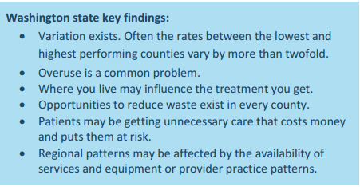

Slide 6
Biggest Opportunities
25% of patients statewide receiving imaging for uncomplicated headaches
Chelan-Douglas 16-17%
37% of patients statewide receiving antibiotics for sinus infections
Chelan-Douglas 39-44%

Slide 7
Biggest Successes
1% of patients statewide receiving CT scanning for sinus infections
4% of women under 21 receiving Pap tests

Slide 8
Chelan/Douglas County (9/14 report) Better, Average, Worse compared to state average
Imaging for uncomplicated headaches
Antibiotics for sinus infections
CT scans for sinus infections
Imaging for uncomplicated low back pain
Imaging for simple syncope
CT scans for appendicitis (too few cases to judge)
Too frequent Pap tests (67% insured, 44% Medicaid)
Yet, only 69% of women 21-64 had a Pap in past 3 years!
Pap tests for patients with previous hysterectomy
Pap tests for women under 21 years old
Follow-up testing for adnexal cysts
Diagnosis/managing asthma without spirometry

Slide 9
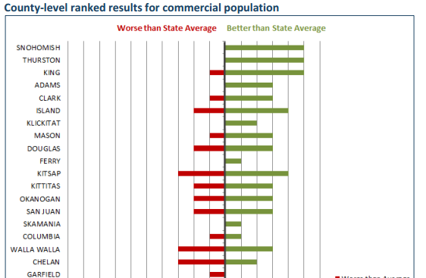

Slide 10
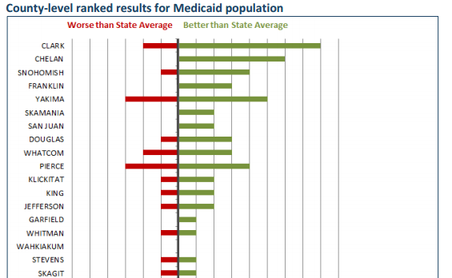

Slide 11
QUESTIONS?

